Slide 1
Lecture 4 Roots of Nonlinear Equations & Curve Fitting: Interpolation
CSE 2207
Numerical Methods

Slide 2
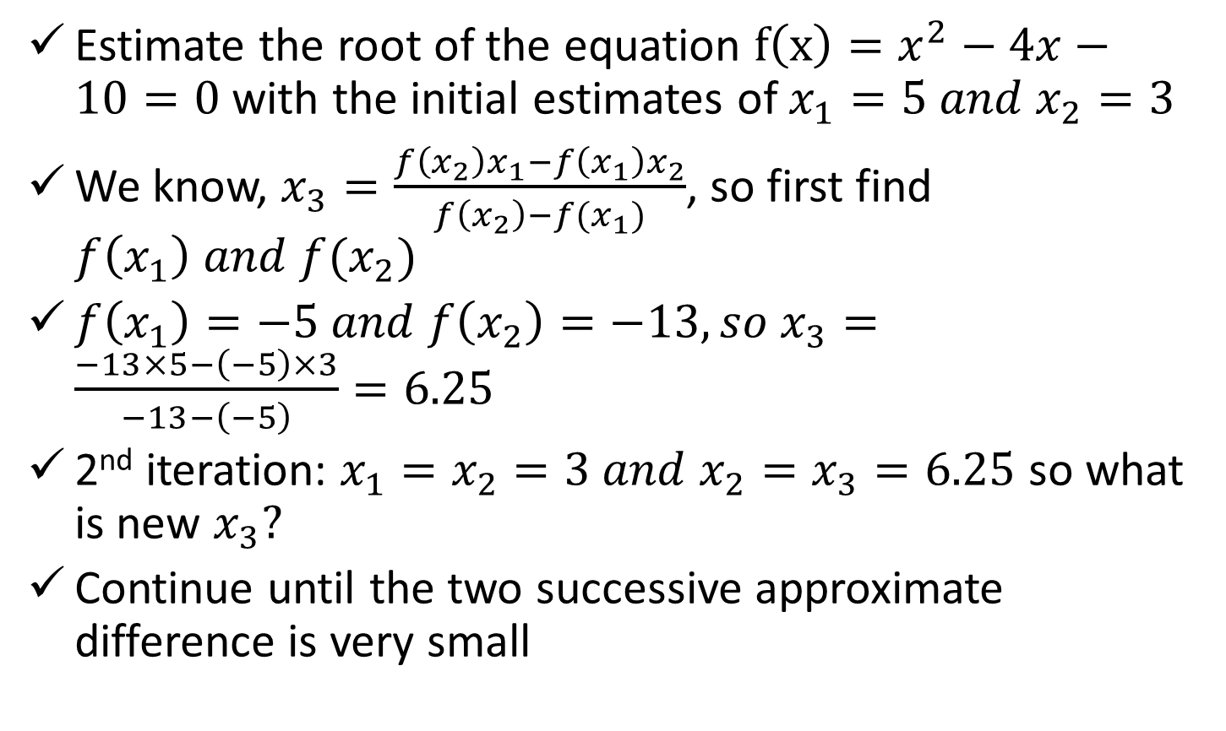
Secant Method (Cont.)
Estimate the root of the equation $f\left(x\right)=x^{2}−4x−10=0$ with the initial estimates of $x_{1}=5 and x_{2}=3$
We know, $x_{3}=\frac{f\left(x_{2}\right)x_{1}−f\left(x_{1}\right)x_{2}}{f\left(x_{2}\right)−f(x_{1})}$, so first find $f\left(x_{1}\right) and f(x_{2})$
$f\left(x_{1}\right)=−5 and f\left(x_{2}\right)=−13, so x_{3}=\frac{−13×5−\left(−5\right)×3}{−13−\left(−5\right)}=6.25$
2nd iteration: $x_{1}=x_{2}=3 and x_{2}=x_{3}=6.25$ so what is new $x_{3}?$
Continue until the two successive approximate difference is very small

Slide 3
Secant Method (Cont.)
How Secant method is different from False position method?
The initial guesses may or may not bracket the root
Has possibility of diverge, if converge, rate is higher than false position, however, False position has guaranteed convergence
Secant method is chosen over Newton-Raphson method, when?
Derivation is difficult, however secant method has slower convergence rate than Newton-Raphson method

Slide 4
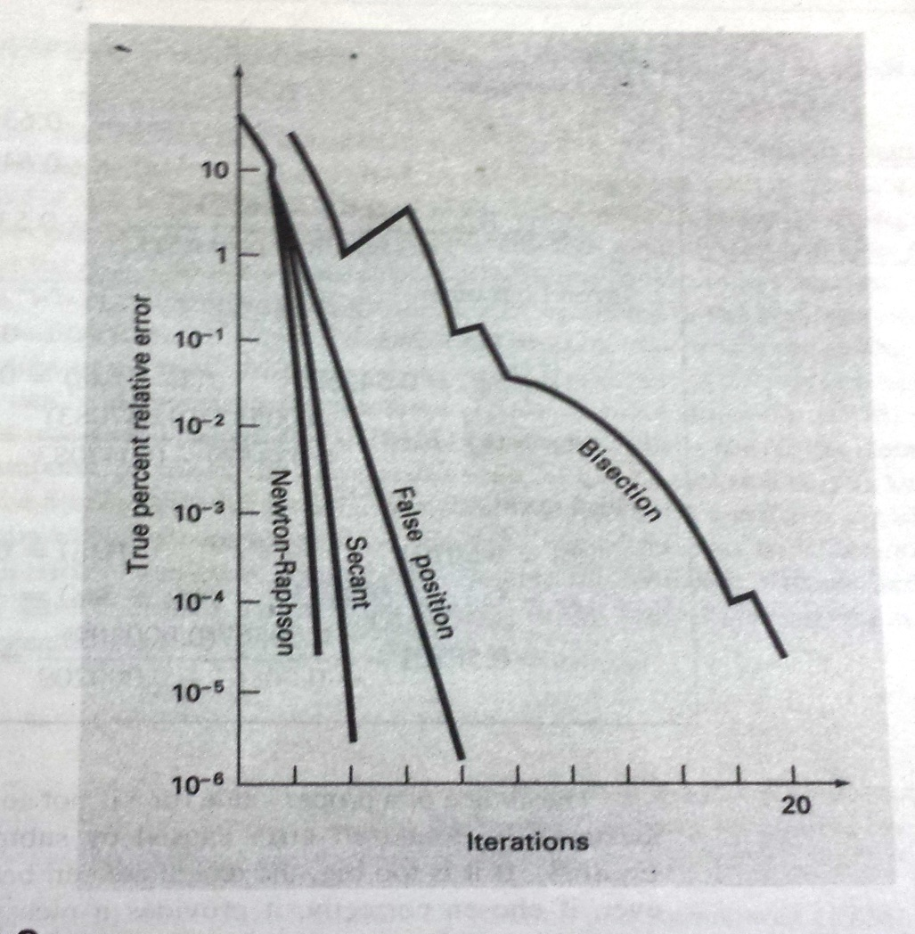
Convergence Comparison
Different methods have different convergence rate

Slide 5
Curve Fitting: Interpolation
Purposes:
To estimate the value of dependent variable y for an intermediate value of independent variable x
e.g. following table is given:
x
1
2
3
4
5
f(x)
1
1.4142
1.7321
2
2.2361
Determine the value of f(x) for x = 3.5

Slide 6
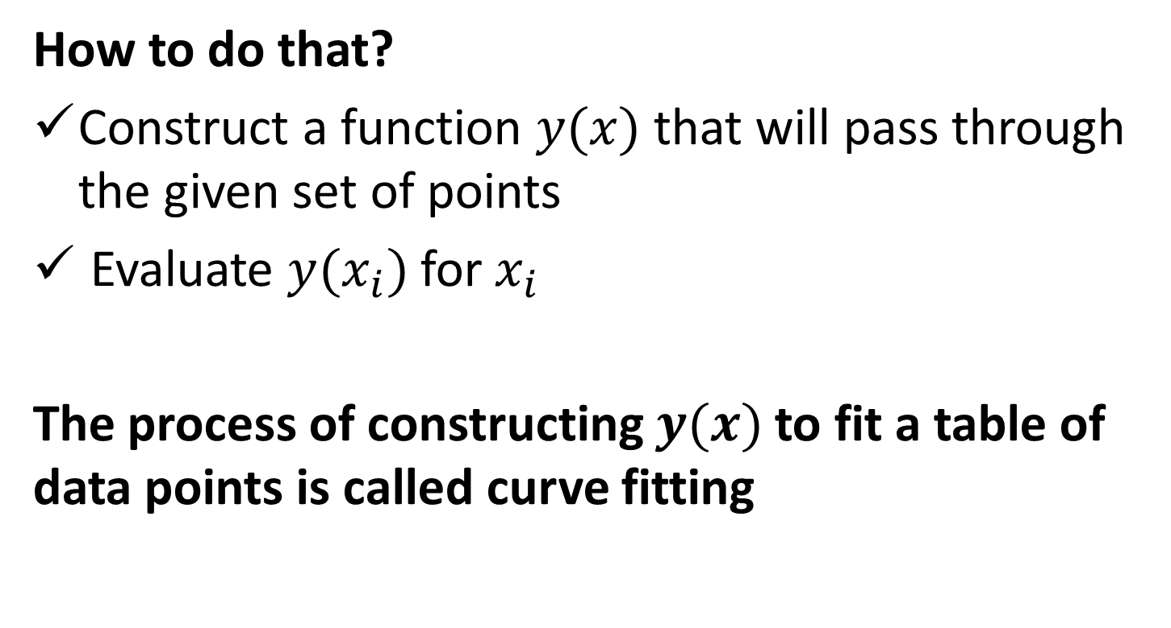
Curve Fitting: Interpolation
How to do that?
Construct a function $y(x)$ that will pass through the given set of points
Evaluate $y(x_{i})$for $x_{i}$
The process of constructing $y(x)$to fit a table of data points is called curve fitting

Slide 7
Curve Fitting: Interpolation
Tabular data points
Table of values of well-defined functions, e.g. logarithmic tables, trigonometric tables. Tables values are accurate
Data tabulated from experimental measurement, e.g. relationship between time vs. temperature raise, applied voltage vs. speed of a fan. Table values are not accurate.

Slide 8
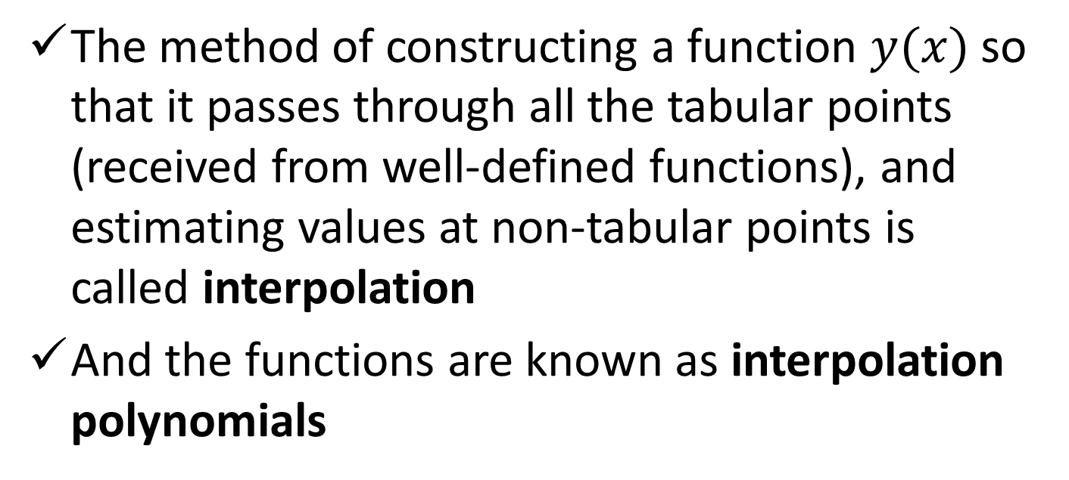
Curve Fitting: Interpolation
The method of constructing a function $y(x)$ so that it passes through all the tabular points (received from well-defined functions), and estimating values at non-tabular points is called interpolation
And the functions are known as interpolation polynomials
Interpolation polynomial
Tabular data points
f(x)
x

Slide 9
Curve Fitting: Regression
The method of constructing a curve that represents the general trend of the experimental data, without necessarily passing through the individuals points is called regression
Such functions are called approximating functions
One of the popular approach is called least-square regression, will be discussed in the next chapter
Interpolation polynomial
Tabular data points
f(x)
Linear approximating function
x

Slide 10
References
Numerical Methods by E Balagurusamy

